Slide 1
INTRODUCTION TO
OBJECT ORIENTED PROGRAMMING

Slide 2
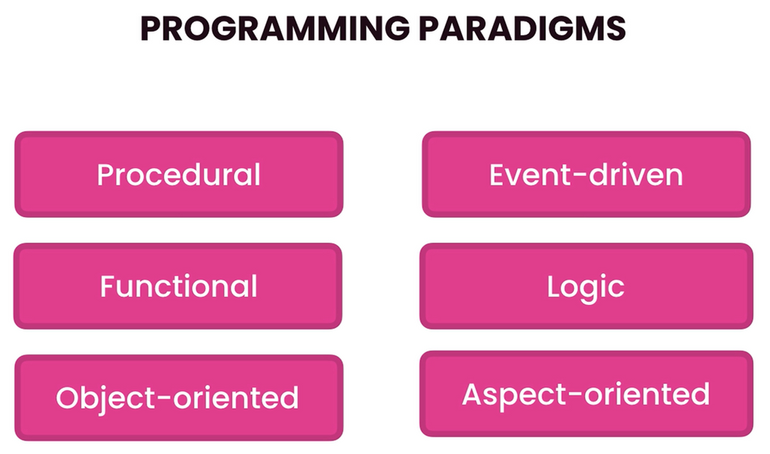
programming paradigm
Programming paradigms are fundamental styles or approaches to programming that guide how developers structure and write code. Each paradigm provides a different model for thinking about software development, influencing how problems are solved and how solutions are expressed.

Slide 3
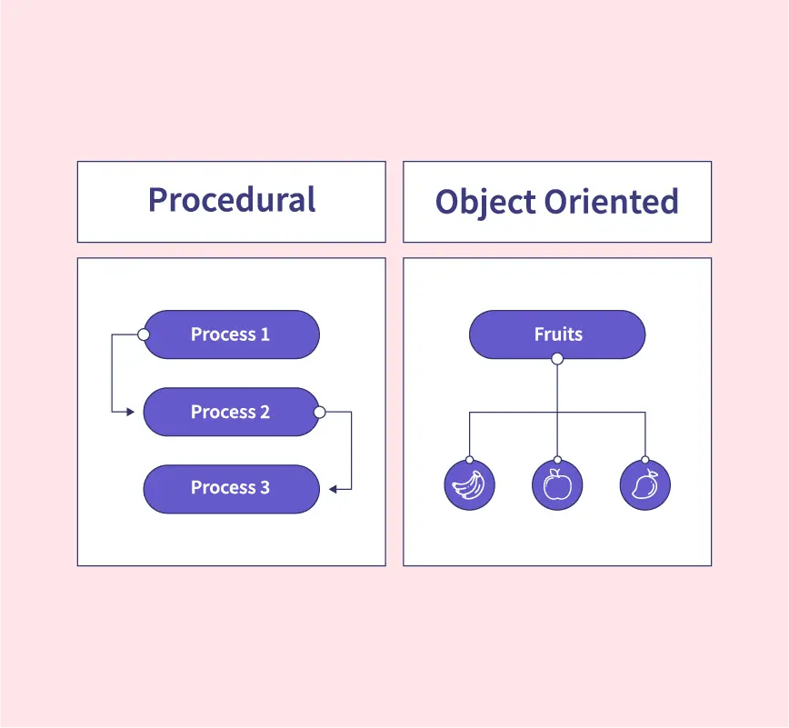
imperative and procedural
Imperative programming focuses on how a program operates. It uses statements that change a program’s state step-by-step, similar to giving a sequence of commands to the computer.
Procedural programming is a structured approach to imperative programming, organizing code into procedures or functions.

Slide 4
object oriented
OOP organizes code around objects, which are instances of classes. Objects combine data (attributes) and behavior (methods).

Slide 5

pre-requisites
JDK, JRE and JVM
IntelliJ/Eclipse
Identifiers and Naming Conventions
Data types: Primitive vs Reference
Variables and Constants
Operators and Expression Evaluation
Reading user input: Scanner
Sequential Structures
Conditional Structures: if, if-else and switch
Repetitive Structures: for, while and do-while
Functions/Methods
Data Structures: Arrays, Lists, etc
Strings

Slide 6

classes
A class is a blueprint for creating objects
It defines the state (fields/attributes) and behavior (methods/functions) of the objects.
When creating classes,
use Pascal naming convention
use nouns
create class members (fields/attributes)
create method/s

Slide 7
attributes
An attribute is a variable declared inside a class but outside any method. These variables hold the data/state for each object created from that class.
When creating attributes,
use camel-casing naming convention
use descriptive nouns
use access modifiers

Slide 8
methods
A method (also known as functions or procedures) is a block of code that is only run when invoked.
Any data passed to a method is called parameters or arguments.
A method can also return data after execution is done.
A method can be pre-defined or user defined.
When creating methods,
use camel-casing naming convention
use verbs as method names
use modifiers (public, static, etc)
specify return type
provide parameters (if necessary)
provide return values (if necessary)

Slide 9
packages
A package is a namespace that organizes a set of related classes and interfaces. Think of it as a folder in your file system that helps prevent name conflicts and makes code easier to manage.
Some built in packages include,
java.lang → core classes (String, Math, Object)
java.util → utility classes (ArrayList, HashMap)
java.io → input/output classes

Slide 10
reference types
Reference types are variables that store the memory address (reference) of an object, rather than the object’s actual value.
With references types,
their initial values are null.
should use equals() for object comparison, not ==
Example of reference types,
String
Date

Slide 11
objects
An object is an instance of a class
To create an instance of a class (or to create/instantiate an object), the keyword new is used.
To set a public attribute of an object, use the dot (.) operator and indicate the attribute.
To call/invoke a public method of an object, use the dot operator (.) and the name of the method

Slide 12
javadocs
JavaDocs are structured comments used to generate HTML documentation for Java code. They are written using special /** ... */ comments, placed above classes, methods, constructors, or fields.
javadocs tags inclue
@param - describes a method parameter
@return - describes what the method returns
@throws or @exception - describes exceptions thrown
@see -references another class or method
@author - author name
@version - version info
@since -specifies since which version it exists
@deprecated - marks a method or class as deprecated

Slide 13
THANK YOU
FOR YOUR ATTENTION

